Slide 1
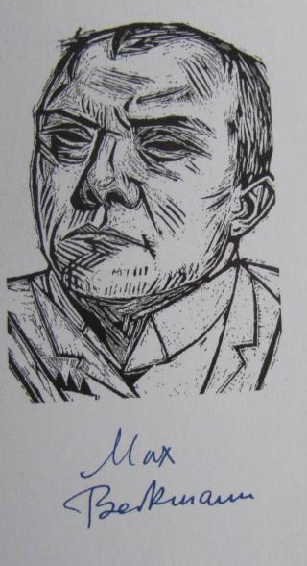
Max Beckmann
Drawings
1922

Slide 2
This presentation is the second out of 3 regarding Max Beckmann’s
creations. Those presentations are available to view at our site:
Max Beckmann-Firth Presentation
Max Beckmann – Third Presentation

Slide 3
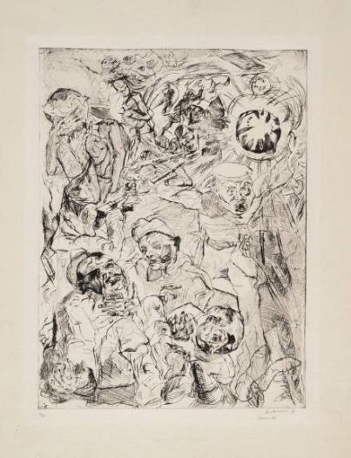
Max Beckmann - Drawings
Painter, printmaker. Known for probing the human condition in portraits, self-portraits, and enigmatic, allegorical tableaus. Emerged in Berlin in early 1910s working in late Impressionist manner. Joined medical corps during World War I. Served in Belgium, where he met Erich Heckel. Discharged after nervous breakdown in 1915. Although he had publicly criticized Franz Marc and the Blaue Reiter’s impulse toward abstraction and spirituality in 1912, harrowing experience of war led him to incorporate strategies of distortion, angularity, and exaggerated color. After war, settled in Frankfurt, but maintained ties to Berlin art circles. Focused on urban themes, especially disaffection of postwar society, and often depicted life as a theater or circus in tightly compressed compositions, which he sometimes elaborated in portfolio format. In mid-1920s compositions became less crowded and more naturalistic.
Made a total of 373 prints, all black and white, with printmaking a major focus between 1914 and 1923. Preferred the scratchy texture of etching and drypoint, but also worked in lithography; made only nineteen woodcuts. Most were issued by leading dealer-publishers, including Paul Cassirer and J. B. Neumann, in Berlin, and Reinhard Piper, in Munich.
More than five hundred works removed from public collections by Nazis in 1937. Waited out World War II in Amsterdam, then assumed teaching positions in St. Louis and New York.
The Grenade
1914

Slide 4
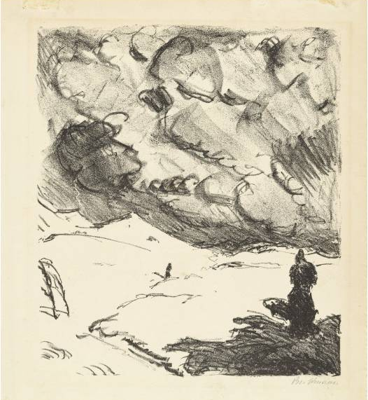
The Departure of Orpheus
1909

Slide 5
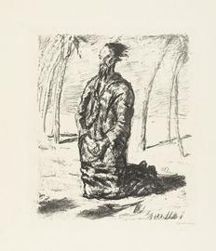
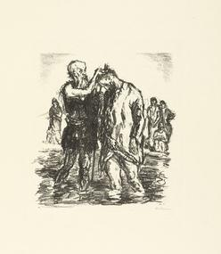
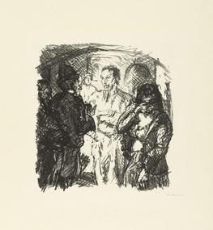
Testament 1911 Six Lithographs to the New
Max Beckmann examines Jesus's human qualities—his inner strength and charisma, his humility and forgiveness, and ultimately his suffering—in this, his first print portfolio. Beckmann manipulates space, light, shadow, and the narrative sequence in order to heighten expressiveness, all formal techniques he would further develop in later prints and paintings.
The series begins with an image of Jesus alone in the desert, steeling himself for the forty-day journey and its attendant trials; although kneeling, he fills almost the entire height of the page. Beckmann then shows Jesus's baptism, his defense of a sinner, the Sermon on the Mount, and the Last Supper. In all of these prints, Beckmann places Jesus at the center of the composition. In the final print, however, he shifts the focus away from Jesus and onto the soldiers who crucified him. With their job complete, they while away time with a game of dice. Their mundane boredom contrasts sharply with the anguish Jesus is experiencing only a few feet away.
Christ in the Desert
The Baptism of Christ
Christ and the Sinner

Slide 6
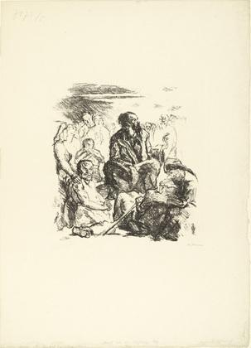
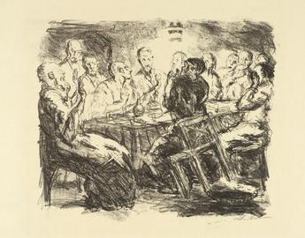
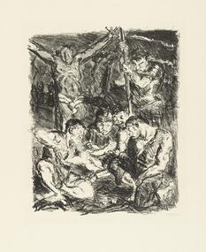
The Last Supper
Throwing Dice
before the Cross
The Sermon on the Mount
Six Lithographs to the New Testament 1911

Slide 7
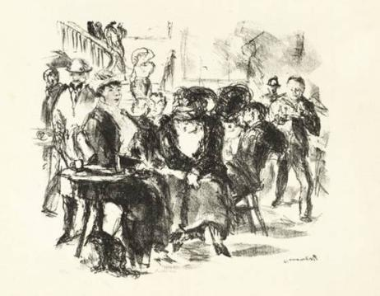
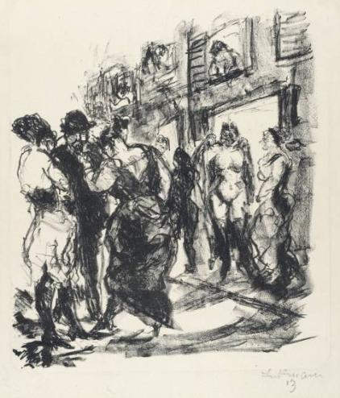
The Café Admiral
1912
Ulrikus Street in Hamburg
1912

Slide 8
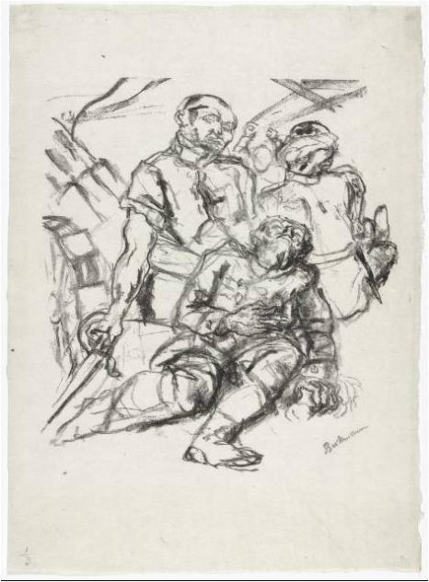
Fallen Soldiers 1914

Slide 9
Weeping Woman 1914

Slide 10
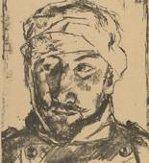
In Memory of a Friend Killed in Action - from the periodical Kriegszeit. 1914

Slide 11
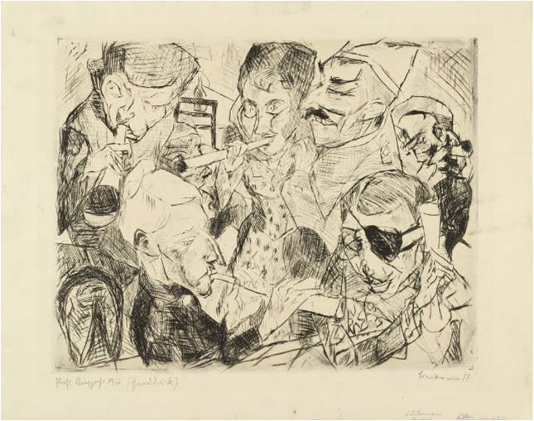
Happy New Year 1917

Slide 12
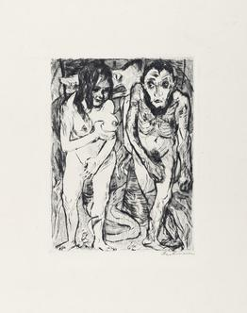
Adam and Eve 1917

Slide 13
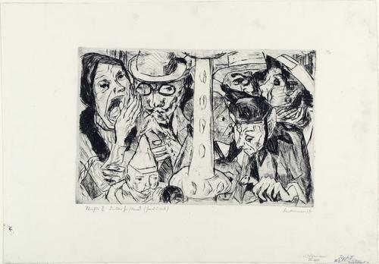
Street II
1917

Slide 14
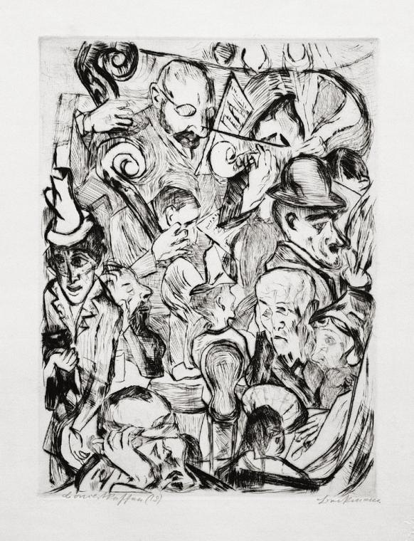
Max Beckmann: Café musik (1918)

Slide 15
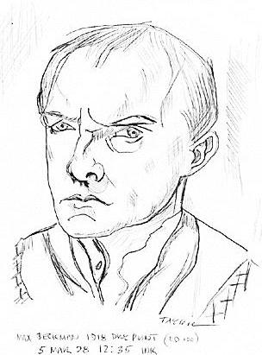
דיוקן עצמי 1918

Slide 16
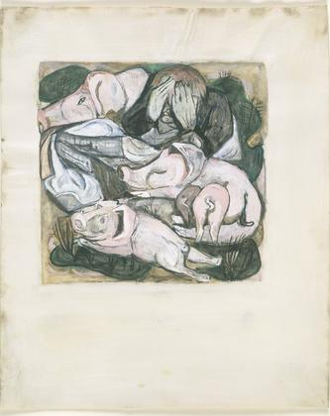
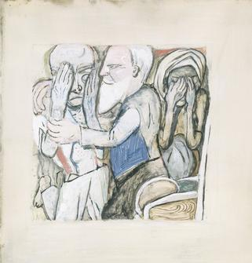
The Return of the Prodigal Son 1918
The Prodigal Son Among Swine 1918

Slide 17
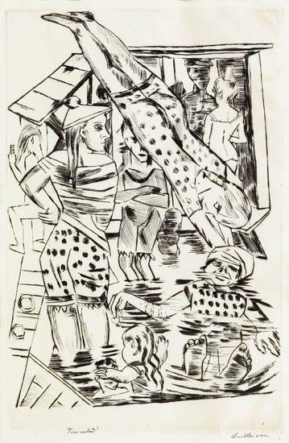
“Women’s Bath” (1919)

Slide 18
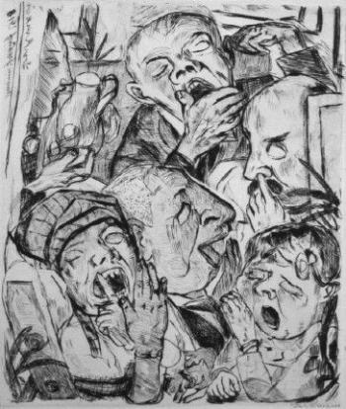
The portfolio Gesichter (Faces) 1919
Faces 1919
The nineteen prints in Max Beckmann's portfolio Gesichter (Faces) do not present a narrative sequence but rather show flashes of life at different moments. Rendered in various sizes and formats and featuring a range of subjects, the images reflect the motley character of human existence: children play war games while bloody soldiers lie on operating-room tables; unattainable desire coexists with the empty pleasures of purchased love; people are bored and lonely, whether at home or in the city, alone or in the crowd. Beckmann, an active participant, appears in multiple self-portraits, including one at each the beginning and the end. Throughout the collection, the artist exaggerated facial features, distorted space, and took full advantage of the scratchy texture of drypoint* lines for expressive effect.
* Drypoint is a printmaking technique of the intaglio family, in which an image is incised into a plate (or "matrix") with a hard-pointed "needle" of sharp metal or diamond point. Traditionally the plate was copper, but now acetate, zinc, or plexiglas are also commonly used. Like etching, drypoint is easier for an artist trained in drawing to master than engraving, as the technique of using the needle is closer to using a pencil than the engraver's burin.
The Yawners

Slide 19
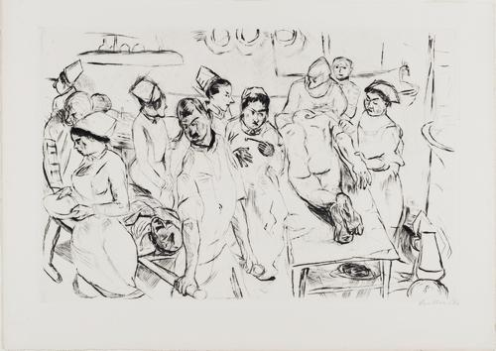
Faces 1919
The Large Operation from Faces 1919

Slide 20
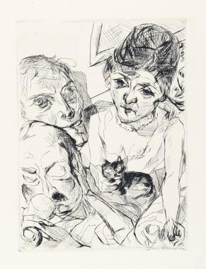
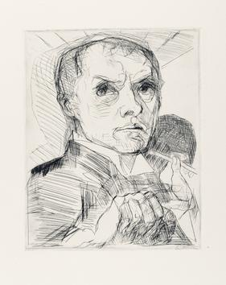
Faces 1919
Self-Portrait with Stylus
Evening (Self-Portrait with the Battenbergs)

Slide 21
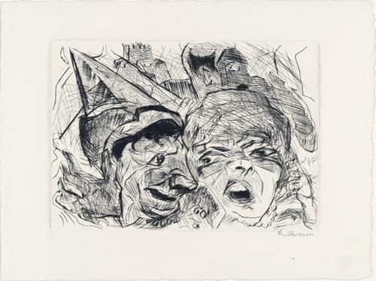
Faces 1919
Theater from the portfolio Faces, 1916

Slide 22
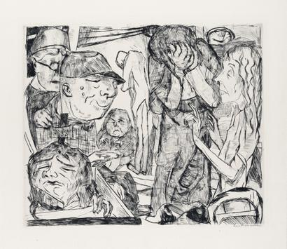
Faces 1919
Madhouse

Slide 23
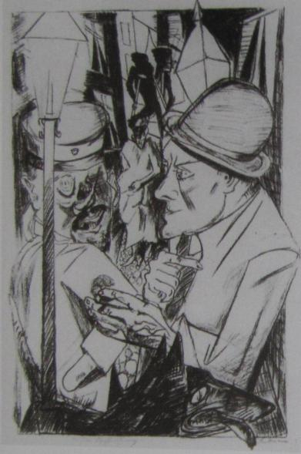
Hell
1919
The portfolio Hölle (Hell) 1919
This portfolio's title describes the social disintegration and violence that gripped Berlin during the immediate postwar period. Beckmann captured the sense of chaos and claustrophobia through fragmented city views, compressed interiors, and contorted bodies that sometimes jut outside his pictures’ borders. His images are social and political allegories, many based on recent incidents, such as the January 1919 murder of Communist leader Rosa Luxemburg, pictured in The Martyrdom. Beckmann himself appears in five prints and on the portfolio cover.
In the first sheet, The Way Home, he encounters a disfigured war veteran on the street. In Night, Beckmann and his family are tortured by intruders in their attic. And in the final print, The Family, Beckmann's young son, Peter, mistakes a grenade for a toy.
The Way Home

Slide 24
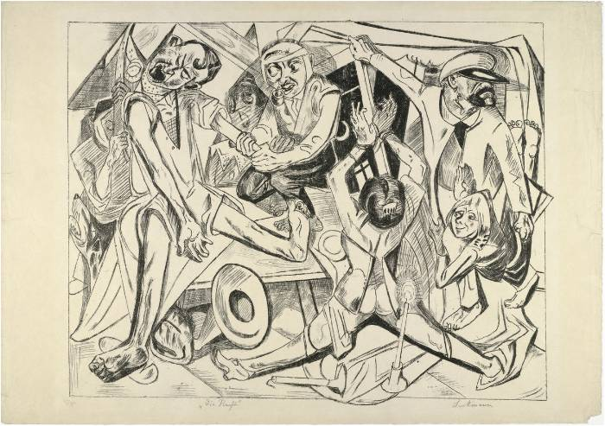
Hell
1919
Night

Slide 25
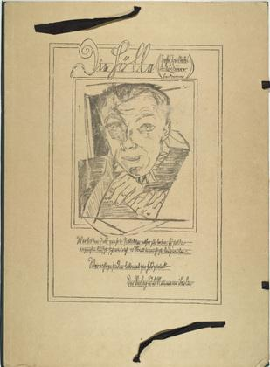
Hell
1919
In the portfolio Hölle (Hell), Max Beckmann journeys, Virgil-like, through Berlin. These ten oversize lithographs present an unflinching look at social disintegration and civil violence after the catastrophe of World War I. Beckmann visited Berlin in March 1919, and depicts himself amid the misery in Hölle; his self-portrait appears in five prints and on the front cover, which, in a handwritten note, promises the viewer an entertaining spectacle.
Unlike many of his compatriots, including the disfigured veteran he encounters in the first print, Der Nachhauseweg (The way home), Beckmann came back whole. He presents a fragmented city, with bodies jutting out of the pictures' frames and figures contorted in impossible spaces. In Die Strasse (The street), a thoroughfare is bustling with daytime activity, yet no one notices the man being carried off, arms flailing, by another man. In Das Martyrium (The martyrdom), under the cover of night, communist leader Rosa Luxemburg is about to be murdered. Speeches, songs, and even last stands are futile. No place is safe: Beckmann transforms an attic into a torture chamber in Die Nacht (Night), while quiet desperation pervades his own family's home in Der Hunger (Hunger). In the final print, Die Familie (The family), Beckmann's young son, Peter, mistakes a grenade for a toy. Beckmann brings the hell of war home in these prints. His publisher, J. B. Neumann, did not sell any when he exhibited them in 1919.
Self-Portrait (front cover)
from Hell

Slide 26
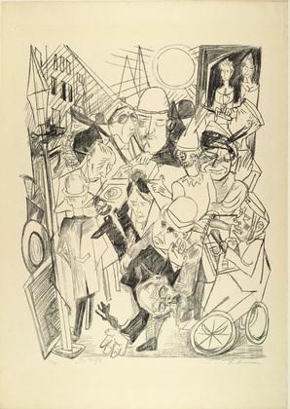
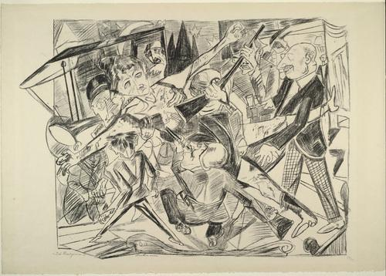
Hell
1919
The Street
The Martyrdom

Slide 27
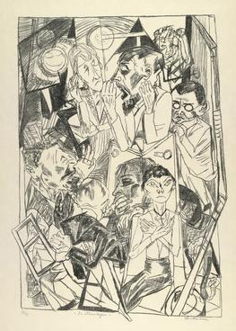
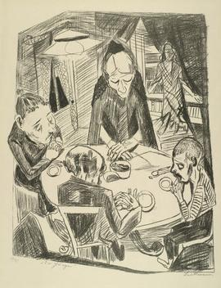
Hell
1919
Hunger
The Ideologists

Slide 28
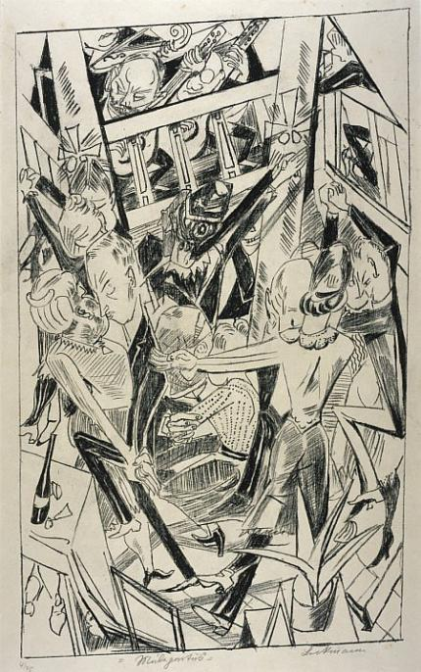
Hell
1919
Malepartus

Slide 29
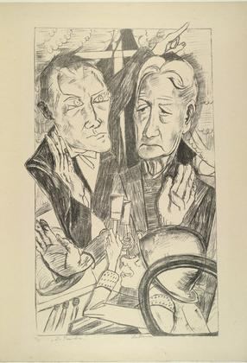
Hell
1919
The Family
[from Hell] 1919

Slide 30
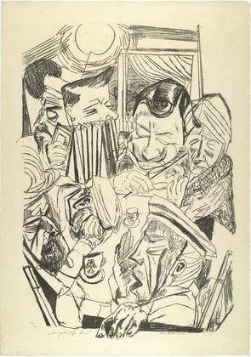
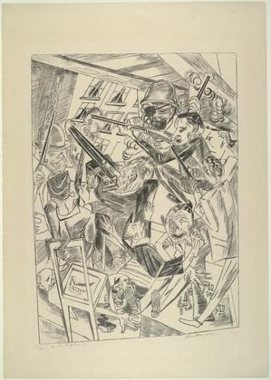
Hell
1919
The Patriotic Song
The Last Ones

Slide 31
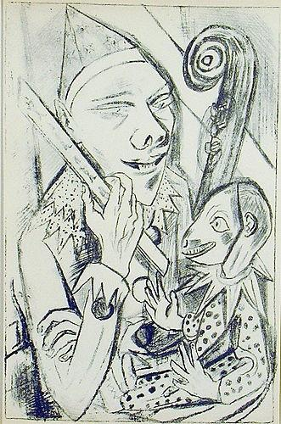
Pierrot and Maskfrom the illustrated book
1920-German Printmakers of Our Time

Slide 32
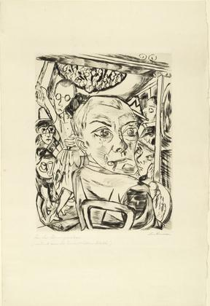
Königin Bar (Self-Portrait) 1920

Slide 33
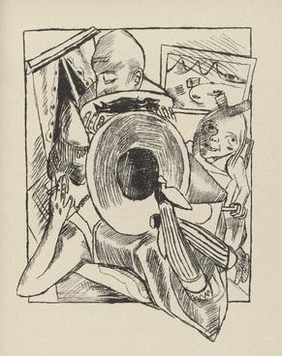
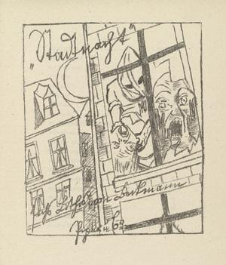
Furnished Room from Stadtnacht (City Night)
Stadtnacht (City Night)
Illustrated book with seven lithographs

Slide 34
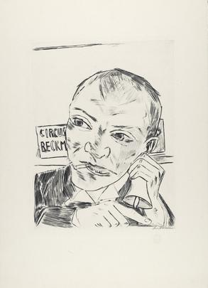
Annual
Fair 1922
(The Barker (Self-Portrait
from Annual Fair
The Portfolio
Annual Fair
1921, published 1922
Max Beckmann imagines the world as a carnival in this portfolio. On the title page, he casts himself as a barker for a traveling band of outsiders, the Circus Beckmann. Shown ringing a bell, and pointing to the edge of the page, he urges viewers to behold the spectacles unfolding within. In Beckmann's theater of life everyone plays many roles: actor, observer, director. The ten rich, velvety drypoints touch upon the major themes he explored throughout his long and productive career: existential crisis, the alienation of modern life, and the insurmountable conflict between the sexes. Beckmann's Expressionist manipulation of space and his pushing together of figures increase the emotional distance between the individuals, who appear to exist only in worlds unto themselves. Actors corralled together backstage wait patiently, not realizing that their true performance—life itself—has already begun. Beckmann conveys female sexuality as a dangerous lure in scenes set in the shooting gallery, on stage, and behind the scenes. In one print, he depicts himself and his wife, Minna, balancing on a tightrope—an allusion to Friedrich Nietzsche's Thus Spoke Zarathustra, in which the philosopher describes man as a "rope" hung over an abyss between base animal and heroic Übermensch.

Slide 35
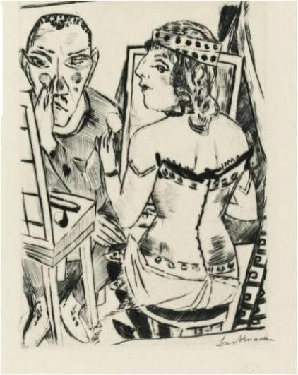
Annual
Fair 1922
Dressing Room

Slide 36
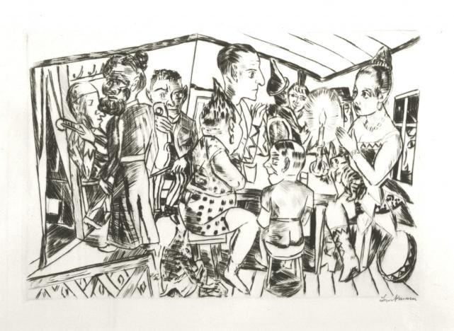
Annual
Fair 1922
Behind the Scenes

Slide 37
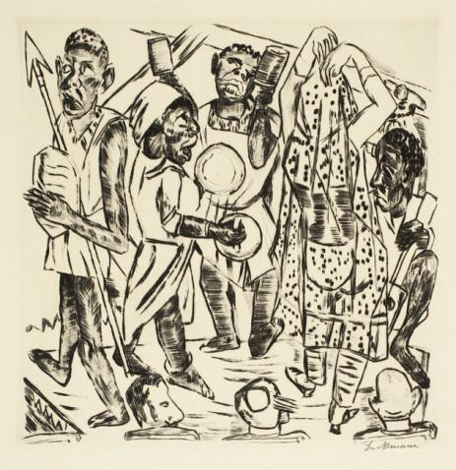
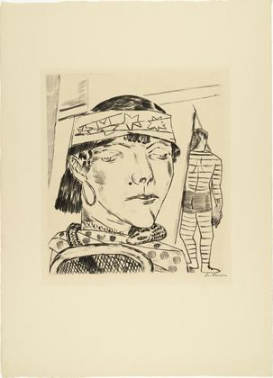
Annual
Fair 1922
Snake Lady
Negro Dance

Slide 38
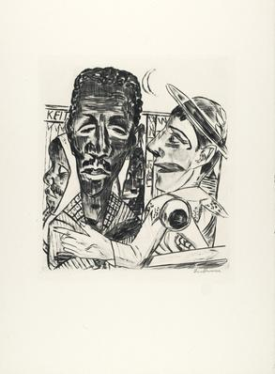
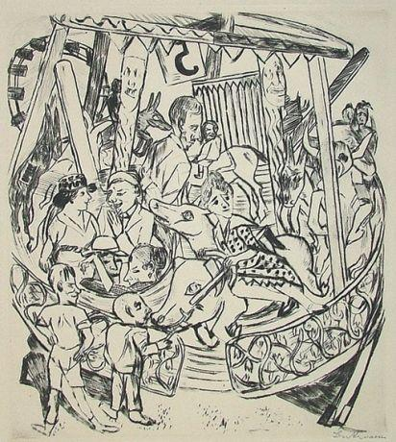
Annual
Fair 1922
The Negro
Merry-Go-Round

Slide 39
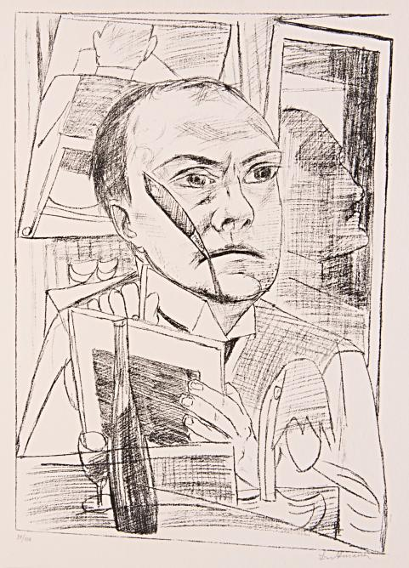
Trip to Berlin 1922
The Portfolio
Trip to Berlin 1922 (Berliner Reise 1922)
As depicted in Max Beckmann's portfolio Berliner Reise 1922 (Trip to Berlin 1922), in the years just after revolutionary upheavals following Germany's defeat in World War I, Berlin is a city of disillusioned people quietly resigned to their fates. Neither politics nor sex can rouse any interest. The rich play cards, attend the theater, and while away the hours in boredom. The poor beg on the street, sleep in cramped quarters, and enjoy the momentary distractions of a dive bar.
In these prints, Beckmann chronicles the many sides of life in the capital of the new Republic. Emphasizing the claustrophobic and discordant, he compresses scenes in tight, window like frames that barely contain the figures that fill them. By contrast, he depicts himself alone in three self-portraits, as an outsider who observes but does not participate, arriving in the city with suitcase in hand, sitting in his hotel room, and, as a chimneysweep in the final print, surveying the city in the new dawn.
Self-Portrait in the Hotel

Slide 40
Trip to Berlin 1922
Night

Slide 41
Trip to Berlin 1922
The Disillusioned II
The Disillusioned I

Slide 42
Trip to Berlin 1922
The Theater Lobby

Slide 43
Trip to Berlin 1922
Striptease

Slide 44
Trip to Berlin
1922
Tavern

Slide 45
The Morgue 1922

Slide 46
Group Portrait, Eden Bar1923, Woodcut

Slide 47
Ebbi
In six penetrating drypoints, Beckmann drew out the conflicting emotions underlying his first play, Ebbi, which he described as a "modern Hamlet." The sharply rendered comedic scenes and absurdist hallucinations express his simultaneous disdain and desire for the comforts of middle-class life.
Bored and restless, Eberhard Kautsch (Ebbi) yearns to become a poet and lead a life unencumbered by his dull family, the daily drudgery of office work, and hemorrhoids. Johanna Löffel, a seductive young painter, spirits him away to a cheap brothel, where his impotence mirrors his inability to overcome conventional morality. There they meet a thug recently released from jail, Jakob Nipsel, whom Beckmann modeled on himself in the illustrations. A wild night of cocaine-induced hallucinations follows. The trio then breaks into the apartment of Ebbi's nouveau-riche friends. Realizing he cannot stomach robbery and murder, Ebbi saves the doorman from Nipsel's violence and returns, a hero, to bourgeois life.
In addition to Ebbi, Beckmann wrote two other plays, neither of which was a theatrical success. Ebbi itself was not performed until 1980. After Beckmann's frequent publisher Reinhard Piper declined to publish the play, Otto Nirenstein agreed to issue a small edition of thirty-three copies through his Johannes-Presse in 1924, and commissioned the illustrations from the artist.
1924 Plate from Ebbi

Slide 48
Man is not a domestic animal
In Stephan Lackner's play Der Mensch ist kein Haustier (Man is not a domestic animal), a violent revolution has unleashed uncontrollable forces in an unnamed land. Felix Faber, logical and heartless, heads the overthrow; his henchman, Peter Giel, betrays him out of love for Duchess Louise. The story follows these three main characters, whose lives remain intertwined as they make their way through the new world.
In 1936 Lackner, then living in exile in Paris, commissioned Beckmann to illustrate his play. At the time, the playwright described himself as "Beckmann's student in a different medium," and stated that Beckmann's art and vision of the world as a theater were the inspiration for the play's main characters. Beckmann, upon reading the finished draft, marveled at the similarities of their ideas. The artist completed the seven lithographs, his first since 1923, shortly after fleeing Nazi Germany in summer 1937. He visited Lackner in Paris, where he signed the prints—an activity that he said reminded him "of better days"—in September. The book was published later that fall. Beckmann's illustrations, in which he gave Giel his own features, focus on the human responses to the upheaval, showing emotional scenes of love, intoxication, and destruction
Second Illustration for Scene 5
From Man Is Not a Domestic Animal

Slide 49
Second Illustration for Scene 10
From Man Is Not a Domestic Animal

Slide 50
Woman Reading 1945

Slide 51
Day and dream 1946
Day and Dream
Max Beckmann blended the real and the imaginary in his final print cycle, Day and Dream, filtering autobiographical elements from his exile in Holland, biblical and mythological tales, and scenes of sexual conflict through his vision of the world as a circus or theater. Oblivious lovers dance while the figure War slumbers, threatening to awake at any moment. Demagogues rise. Children refuse to eat their soup. Beckmann here revisited subjects he had explored throughout his career, suggesting that nothing changes and everything comes back.
Beckmann depicted himself throughout the portfolio, appearing as a figure who has seen and experienced it all. In the final print, he stands as Pontius Pilate across from the crucified Jesus. After another world war, Beckmann held little hope for salvation—for himself or for humanity.
Self-Portrait
Amsterdam-1946

Slide 52
Day and dream
I Don't Want to Eat My Soup

Slide 53
Day and dream
King and Demagogue

Slide 54
Day and dream
Dream of War

Slide 55
Day and 1946dream
Christ and Pilate

Slide 56
Day and 1946dream
Magic Mirror

Slide 57
1948Woman with Fish from the illustrated book Max Beckmann

Slide 58
Rodeo, 1949

Slide 59
Source:
http://www.moma.org/explore/collection/ge/portfolios
“Society”, 1918
Clarita-Efraim pps:
www.clarita-efraim.com
chefetz@clarita-efraim.com

